Slide 1
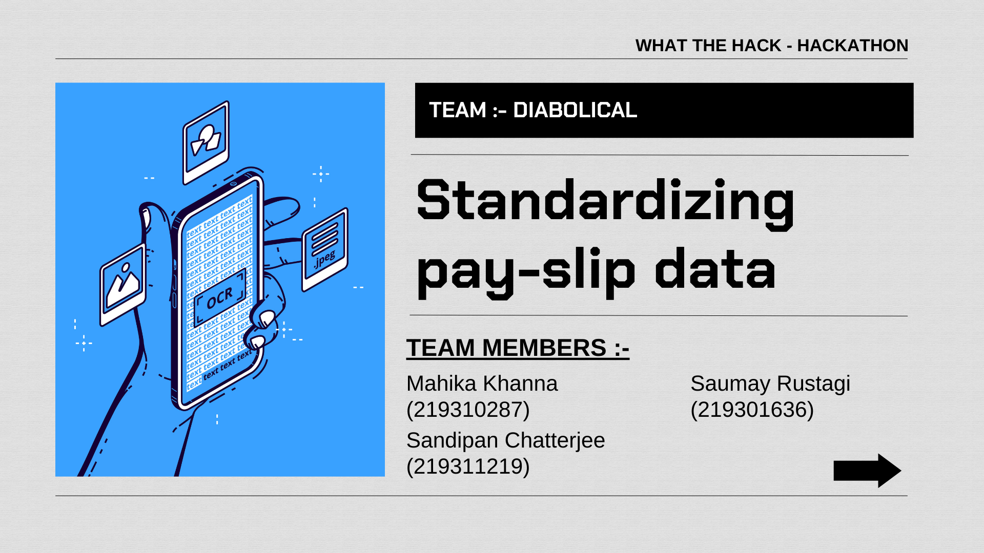
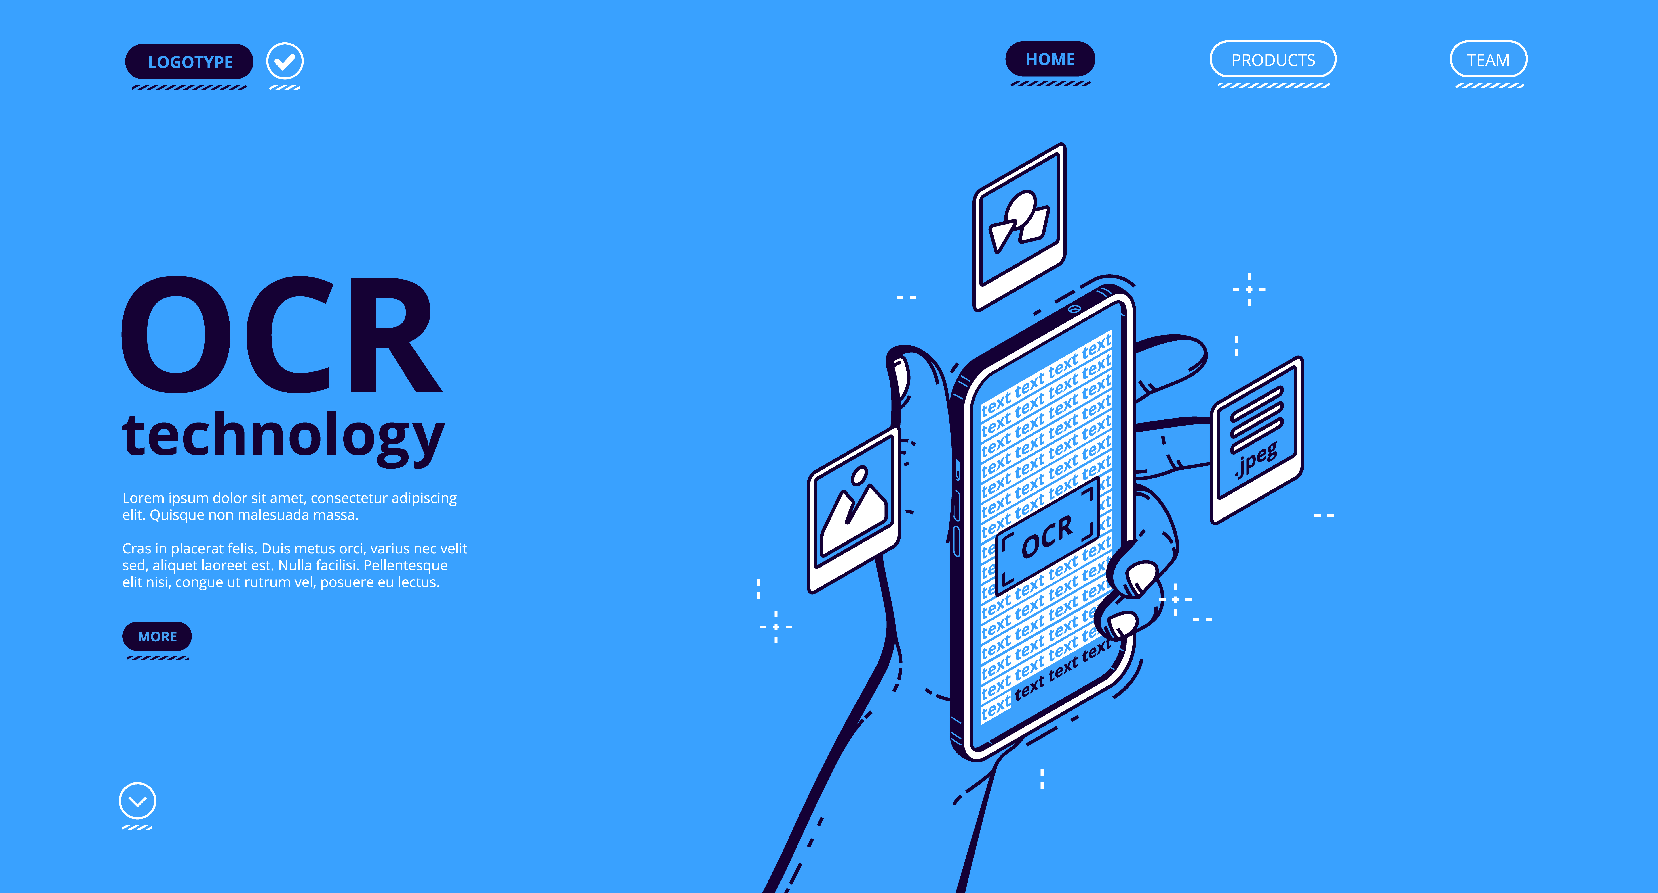

Standardizing pay-slip data
WHAT THE HACK -Hackathon
TEAM :- DIABOLICAL
TEAM MEMBERS :-
Mahika Khanna
219310287
Saumay Rustagi
219301636
Sandipan Chatterjee
219311219

Slide 2


Slide 3
PROBLEM STATEMENT
Companies use different labels for employee data on their salary pay slips. OCR treats these labels as distinct objects even when they refer to the same information. This leads to inconsistent processing of data.
For example, the two labels on the right measure the same quantity but would be treated as completely different by OCR.
These inconsistencies multiply and pose problems when trying to parse data on a large scale.

Slide 4
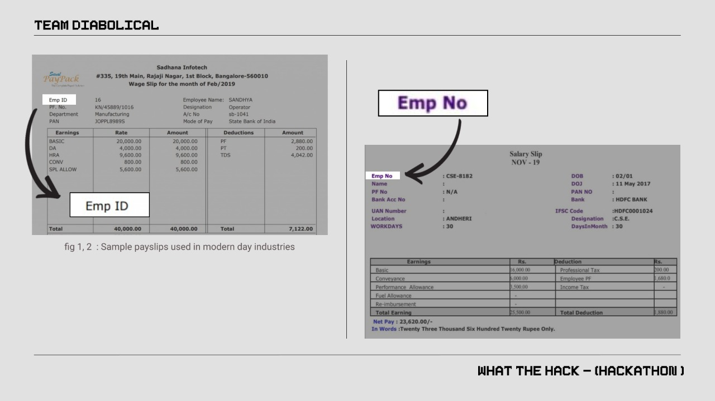

Slide 5
ALGORITHM ANALYSIS
We start by mapping short forms of the most commonly used terms onto their first occurring letters. Example – PAN on ‘P’ and HRA on ‘H’. We also store all
the full-forms in a separate array.
We compare the initials of the input field against all the short-forms in the map. In case we get a match, the quantity is stored in the variable assigned for it. If not, we compare the word against the array of full-forms.
Here, we specify a certain *Levenshtein distance between two words to ascertain how similar they are. The lower the distance, the higher their similarity.
We take the word with the least Levenshtein distance (under a certain upper bound) from the input and store its value into the corresponding field.
After we have parsed the data into variables, we pass them into an SQL Database, streamlined and ready for processing.
*Levenshtein distance: the minimum number of single-character edits (insertions, deletions or substitutions) required to change one word into the other.

Slide 6
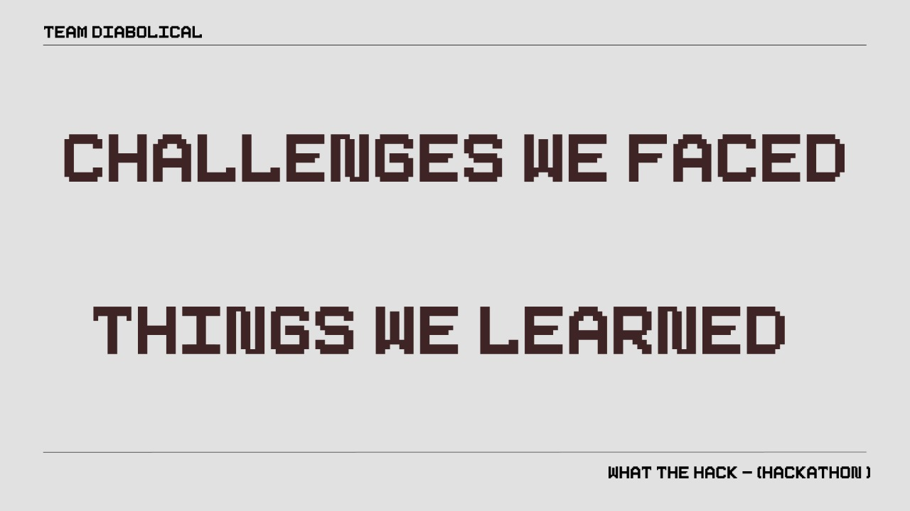
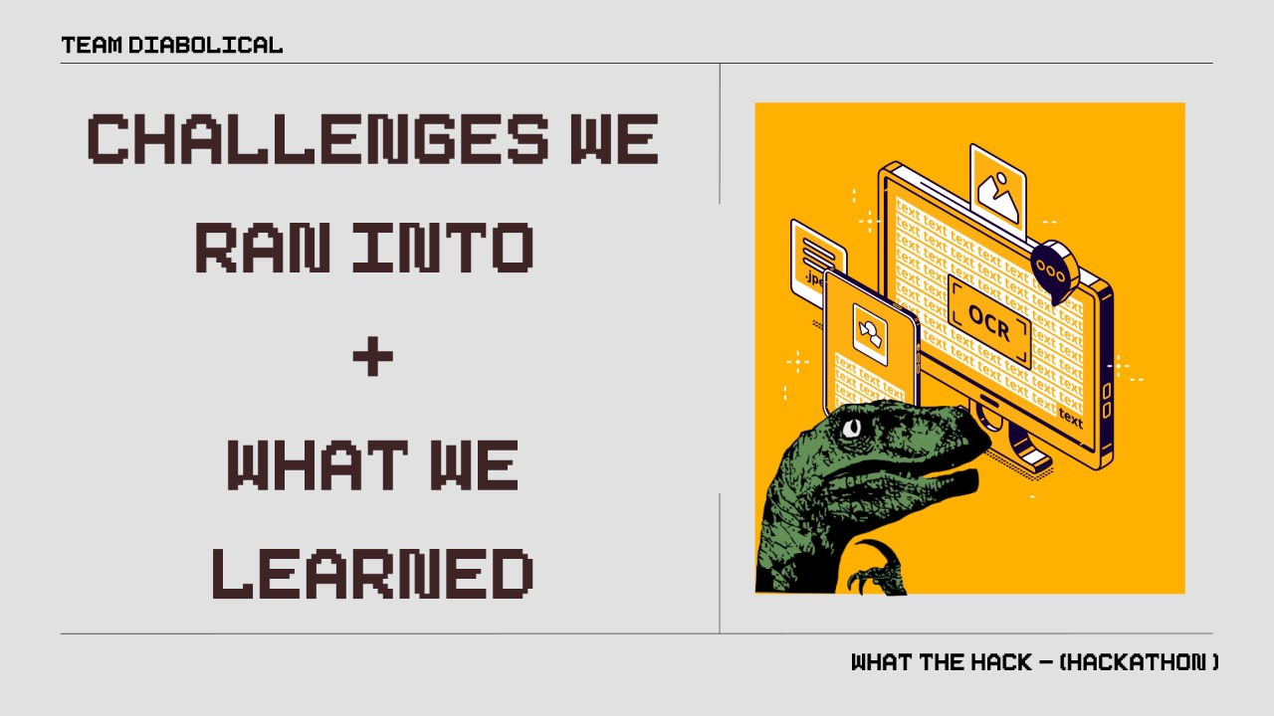

Slide 7
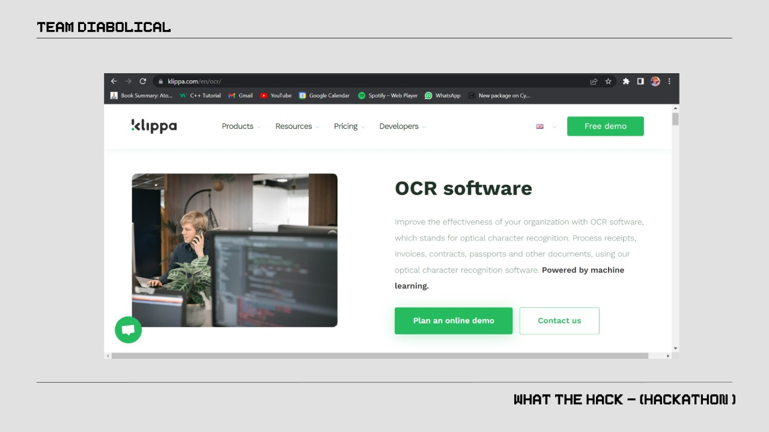

Slide 8
